Slide 1

Wind Speed Retrieval using Machine Learning
Lalith Sai Madhav Rayala(1226017093)
Anupama Kanchustambam (1225758846)

Slide 2
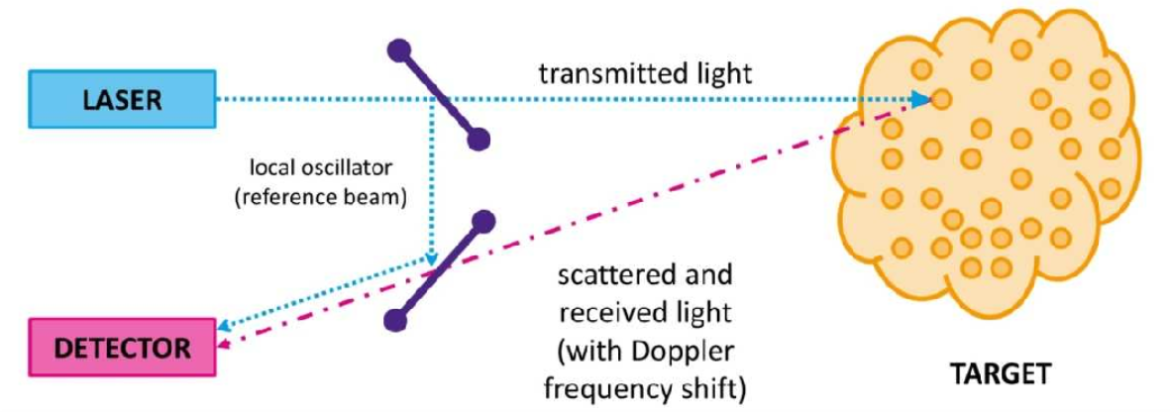
Doppler Lidar
The laser beam interacts with tiny atmospheric particles, such as dust, aerosols, or molecules. When the laser light hits these particles, some of it is scattered in various directions.
The scattered light that returns to the Lidar is analyzed to measure the Doppler shift. The Doppler shift is the change in frequency of the scattered light compared to the emitted laser light. It occurs when the atmospheric particles are in motion, such as moving with or against the wind.
By analyzing the Doppler shift, the Lidar can determine the speed and direction of the wind in the region of interest. The frequency change in the scattered light is directly related to the wind speed, allowing the Lidar to provide valuable information about the atmospheric flow patterns.
Doppler Lidar starts by emitting a laser beam into the atmosphere toward the region of interest where wind measurements are desired.

Slide 3
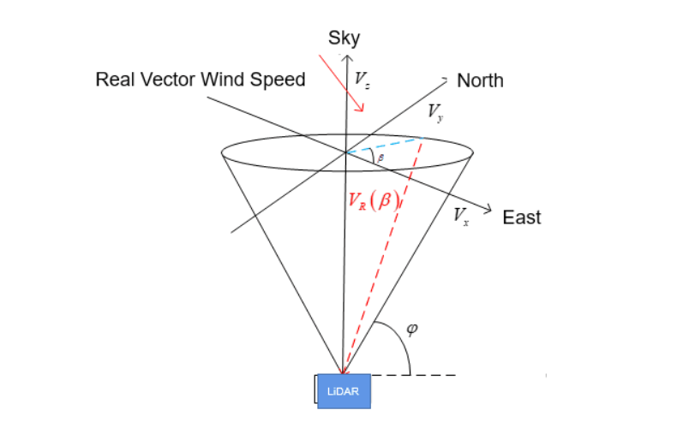
Wind Speed Vector Retrieval
Wind speed obtained from Doppler Lidar is a scalar wind speed value along the Doppler Lidar propagation path.
But wind speed is a vector quantity.
Wind speed retrieval methods are used to retrieve vector wind speeds.
One of the popular methods used for the wind speed retrieval is the velocity azimuth display method.

Slide 4
Model Outline
Machine Learning Model
Doppler Lidar Radial Wind Speed
Vector Wind speed from Towers
Inputs
Target Variable

Slide 5
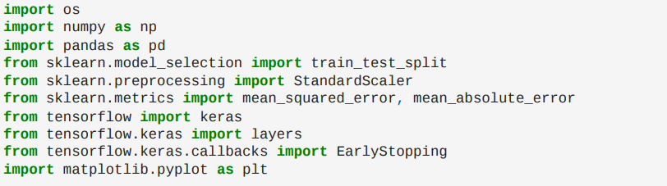
Our Model
Neural Networks
sklearn
Tensor Flow
Used Neural Networks for Machine Learning.
Implementing the model using TensorFlow, a powerful open-source machine learning library.
Leveraging the Keras API within TensorFlow for a high-level and user-friendly approach to building and training neural networks.

Slide 6
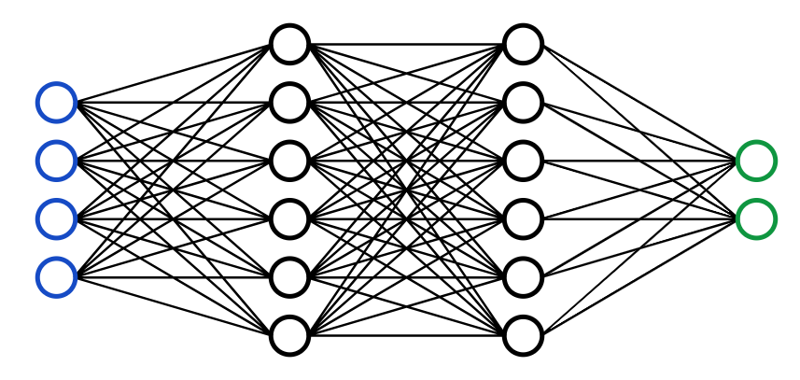
Why Neural Networks
Neural networks excel at capturing complex, nonlinear relationships
Their ability to automatically learn hierarchical representations facilitates effective feature discovery, crucial when dealing with multi-modal data sources such as Lidar and Sonic anemometer readings.
Neural networks are adaptable to variations in data patterns, allowing them to adjust to the dynamic and diverse nature of atmospheric conditions, a key advantage in real-world wind speed forecasting.
With parallel processing capabilities, neural networks efficiently handle large datasets, a valuable feature when dealing with extensive Lidar and Sonic anemometer data for training and prediction.
The flexibility in model architecture, coupled with the integration of TensorFlow and Keras, provides a powerful environment for designing and training models tailored to the complexities of wind speed retrieval.

Slide 7
Our data source
Downloaded the data from https://a2e.energy.gov/home.
Atmosphere to Electrons (A2e) is a new, multi-year, multi-stakeholder U.S. Department of Energy (DOE) research and development initiative tasked with improving wind plant performance and mitigating risk and uncertainty to achieve substantial reduction in the cost of wind energy production.
Windcube Lidars often utilize Doppler Beam Swinging (DBS) technology for wind profiling. This technique involves swinging the laser beam in different directions to obtain wind speed measurements at various azimuth angles, allowing for a comprehensive characterization of the wind field.
Data Used for training and testing the model
Surface Meteorological Station Tower data – Troutdale, Oregon, US.
Windcube Lidar, Troutdale
Surface Meteorological Station, Tower data– Wasco, Oregon, US
Windcube Lidar, Wasco Airport

Slide 8
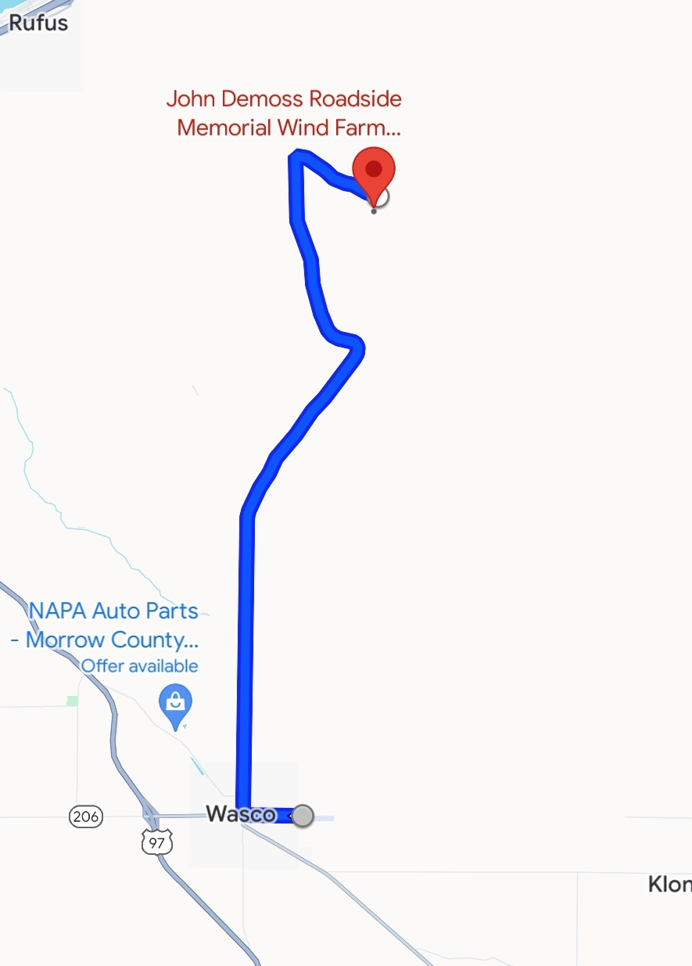
Our data source
Wasco Airport, data:
The tower data is from a wind farm near the airport.
The radial wind speed is from the CU Windcube Lidar which is located at the airport.
Tower data at 50m, 60m height
Sonic Anemometer
Troutdale data:
The tower data and the Lidar are both from the Airport in Troutdale, Oregon, US
Lidar data from CU Windcube

Slide 9
Code Implementation
Importing Libraries
Defining Functions
Reading & Preprocessing Data
Data Cleaning & Merging
Model Compilation & Training
Neural Network Model Building
Data Splitting & Feature Standardization
Selecting Features and Handling NaNs
Model Evaluation
Predictions & Performance Metrics
Plotting Results

Slide 10
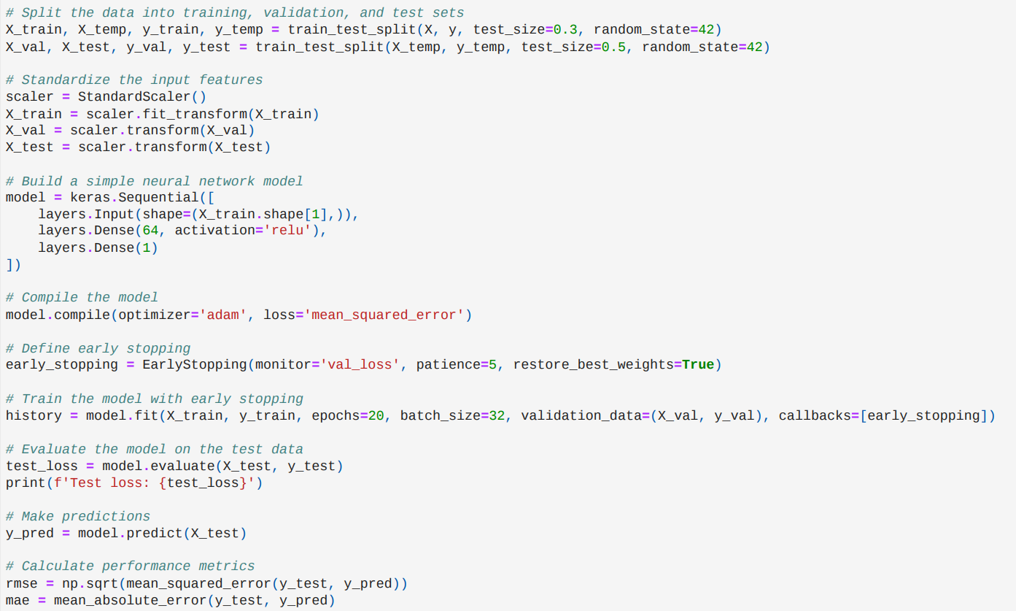
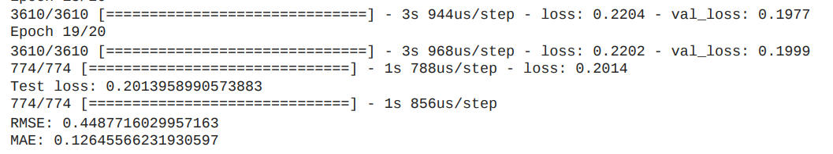
Troutdale Airport Results
RMSE : 0.44
MAE: 0.12
Test Loss: 0.2013

Slide 11
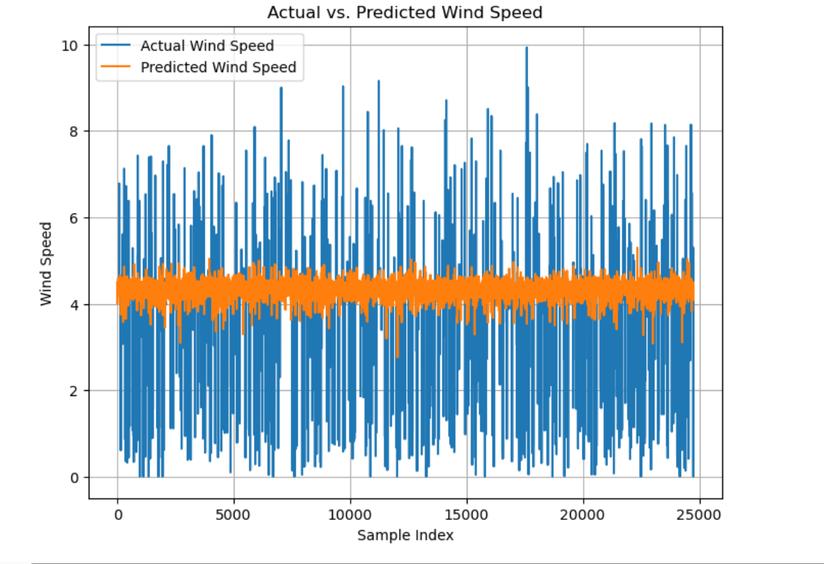
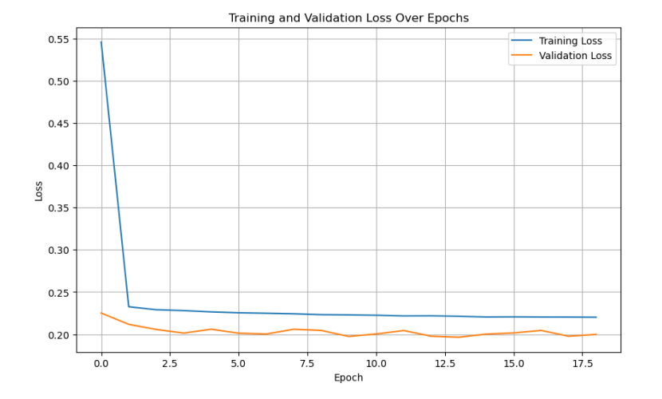
Troutdale Airport Results

Slide 12
What do the results mean?
The results reflect the performance of a neural network model that has been trained to predict wind speeds using data from LiDAR and wind tower measurements. Here's what each part of the output means:
Epochs and Loss: During training, your model went through 20 epochs, which are full iterations over the entire dataset. The loss is a measure of how well the model is doing, with lower values indicating better performance. The training loss generally decreases over epochs as the model learns. The validation loss is a measure of model performance on a separate part of the data not used for training, which helps in gauging how well the model generalizes. Early stopping is used to prevent overfitting, and it stops the training if the validation loss does not improve for a set number of epochs (patience parameter).
Final Test Loss: The test loss of 0.2014 is the mean squared error on the test dataset. It's the average of the squares of the differences between the predicted and actual values. This is the final evaluation of the model after training and indicates how well the model is expected to perform on unseen data.
RMSE and MAE: RMSE (Root Mean Squared Error) of 0.4488 is a standard way to measure the error of a model in predicting quantitative data. It represents the square root of the second sample moment of the differences between predicted values and observed values or the quadratic mean of these differences. Lower RMSE values are better, and they indicate that the predicted values are close to the actual values.
MAE (Mean Absolute Error) of 0.1265 is the average of the absolute differences between the predicted and actual values. It gives an idea of how wrong the predictions were. The lower the MAE, the better the model's predictions are
Plots: The 'Actual vs. Predicted Wind Speed' plot shows the comparison between the actual wind speeds from the test set and those predicted by your model. Ideally, these two lines would overlap, indicating perfect predictions. The density of the points (especially in the orange line for predicted wind speeds) indicates variability in prediction accuracy.
The 'Training and Validation Loss Over Epochs' plot demonstrates how the loss decreased over each epoch during training. The closer the validation loss is to the training loss, the better your model is at generalizing to new, unseen data.

Slide 13
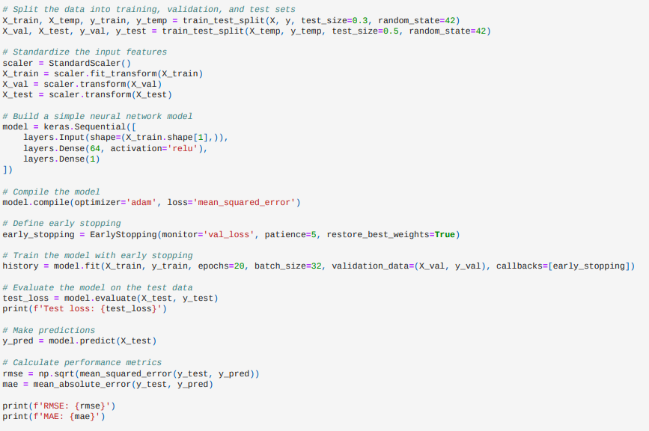
Wasco Airport Results
RMSE : 1.63
MAE: 1.54
Test Loss: 0.2688

Slide 14
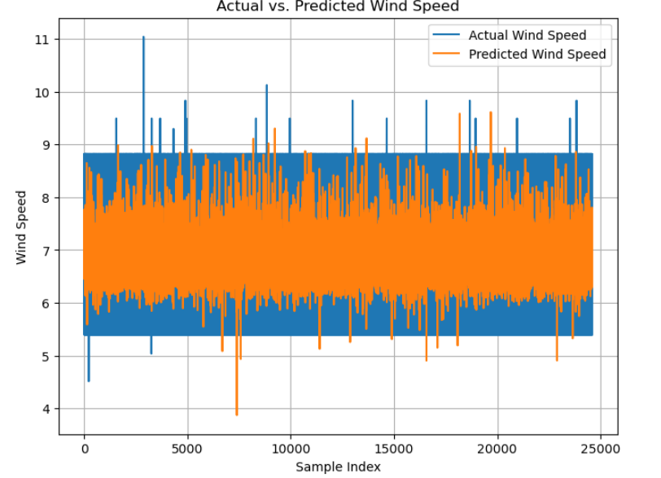
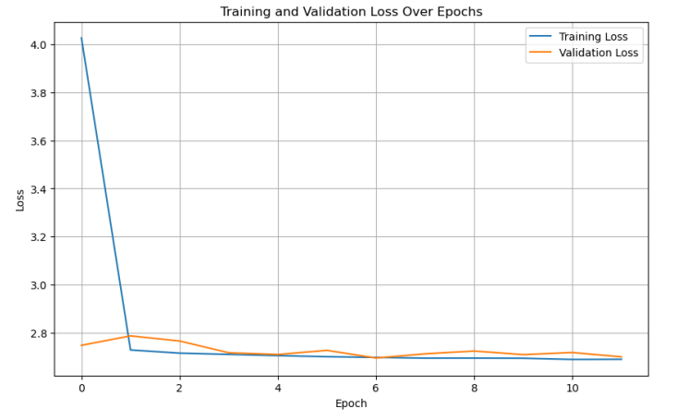
Wasco Airport Results

Slide 15
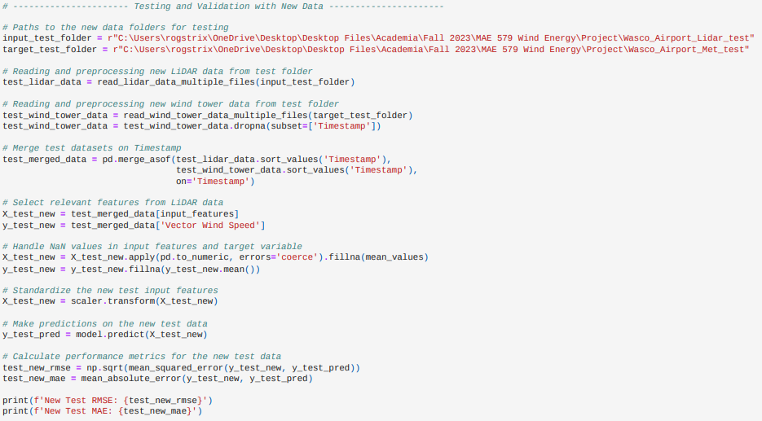

Wasco data on Troutdale trained model
RMSE: 4.84
MAE: 4.8

Slide 16
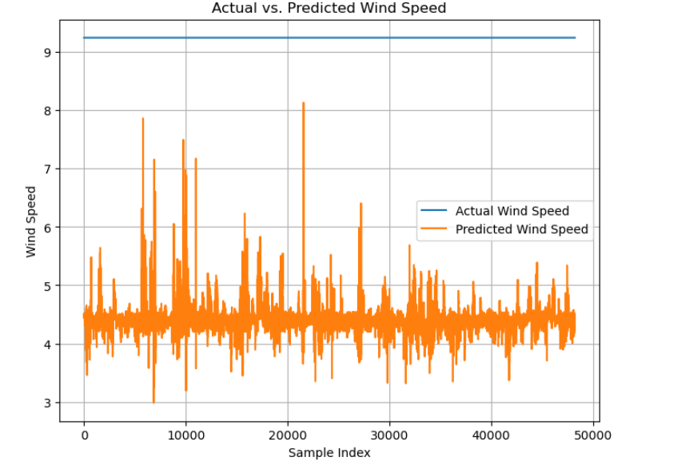
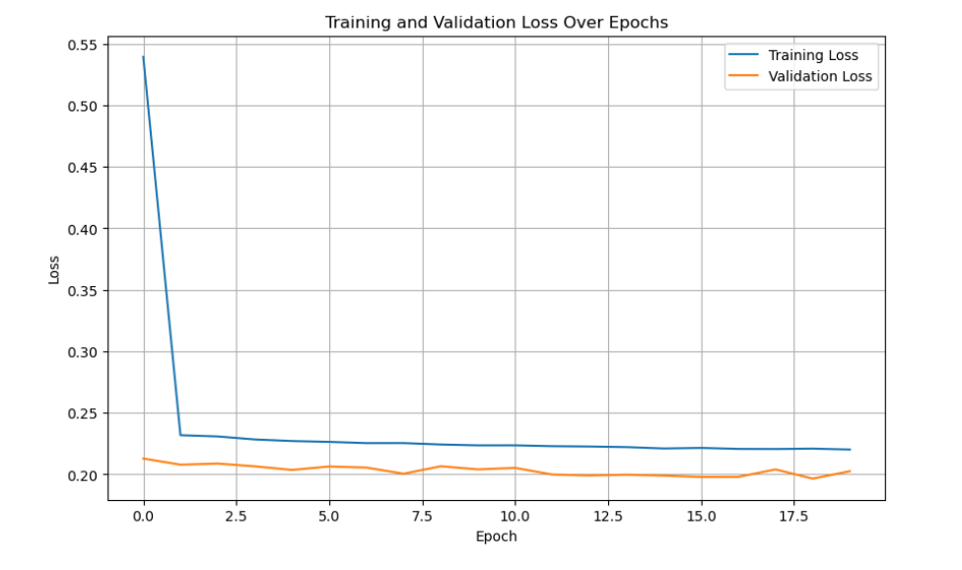
Testing Wasco on Troutdale trained model

Slide 17
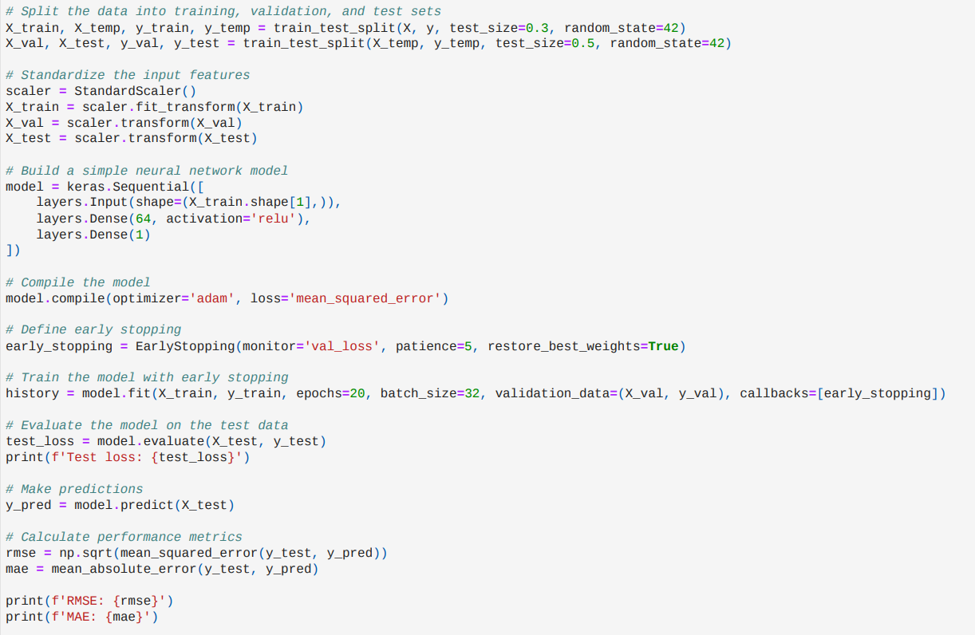
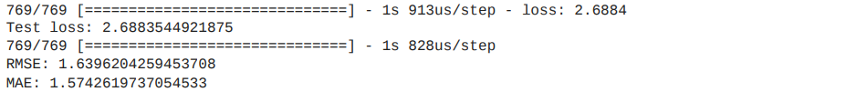
Training and testing with both datasets
RMSE: 1.63
MAE: 1.57
Test Loss: 2.68

Slide 18
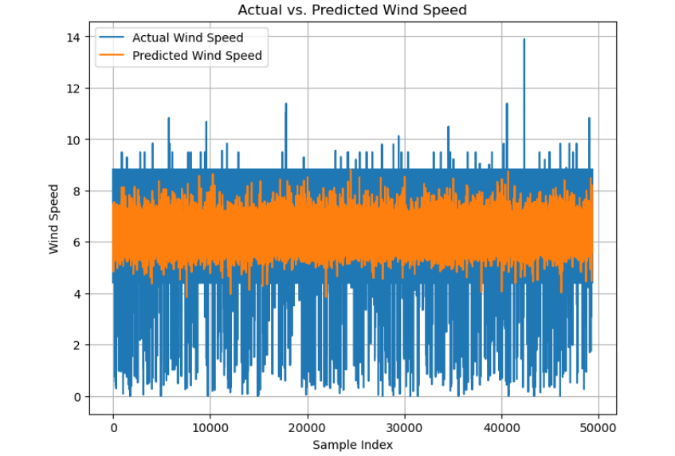
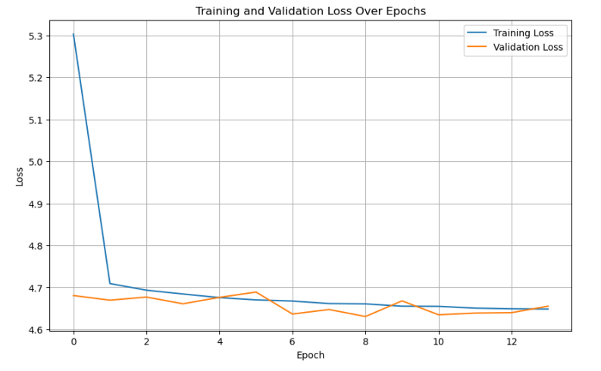
Training and testing with both datasets

Slide 19
What do we infer out of this?
The volume of data pertaining to a specific site is directly proportional to the precision of our results. A larger dataset enhances the model's ability to capture the variability and complexity of wind patterns at a single location, leading to more accurate predictions.
The dataset at our disposal, spanning approximately 11-12 months, demonstrates limitations when applied to predict conditions at a disparate location. The diminished accuracy in such scenarios can be attributed to several factors:
a) The discrepancy in the input features between datasets from different sites introduces challenges. A direct match in the features is crucial for the transferability of the predictive model.
b) Geographical influences are significant in determining wind behavior, and these are inherently site-specific. The unique geographical attributes of each location need to be factored into the model for it to make accurate predictions across various sites.
c) The relative positioning and setup of the measurement equipment at each site can cause variations in data capture, further complicating the task of generalizing the model from one location to another.
In conclusion, while our model shows competency in site-specific wind speed prediction, the generalization to other locations is hindered by differences in datasets and site characteristics. This emphasizes the need for tailored models that accommodate the unique features and conditions of each new site.

Slide 20
Is the Model Learning? Or Memorizing?
Data Splitting:
Train data: Used for training the model.
Test data: Reserved for evaluating model performance on unseen examples.
Early Stopping:
Implemented early stopping based on loss
Training halted when the model's performance on the validation set stopped improving.
Generalization Check:
Ensured the model's performance extends beyond the training data.
Learning Curves Analysis:
Examined learning curves over epochs.
Looked for consistent improvements on both training and validation sets.

Slide 21
Limitations in the project
Data Consistency:
Data collected from different sources lacked consistency.
Potential variations in data format, quality, or collection methods.
Averaging Discrepancy:
Inconsistency in data averaging intervals.
One dataset is 2-minute averaged, while the other is 10-minute averaged.
Interpolation Challenges:
Dealing with challenges in interpolating or aggregating data to achieve uniformity.
Potential loss of information or introduction of artifacts during data processing.
Data Handling Challenges:
Faced limitations in handling large volumes of data efficiently.
Absence of an optimized system for processing, storing, and managing extensive datasets.

Slide 22
References
Enhancing offshore wind resource assessment with LIDAR-validated reanalysis datasets: A case study in Gujarat, India, Kantipudi MVV Prasad a, Garlapati Nagababu b, Hardik K. Jani b
Measurement and Prediction of Wind Fields at an Offshore Site by Scanning Doppler LiDAR and WRF, Jay Prakash Goit, Atsushi Yamaguchi and Takeshi Ishihara
https://a2e.energy.gov/data#
Coherent Doppler lidar for wind farm characterization R. Krishnamurthy1 , A. Choukulkar 1 , R. Calhoun 1 , J. Fine2 , A. Oliver 2 and K.S. Barr 3
Nonlinear model predictive control of wind turbines using LIDAR David Schlipf 1 , Dominik Johannes Schlipf 2 and Martin Kühn3
Abkar, M., Sørensen, J., & Porté-Agel, F. (2018). An analytical model for the effect of vertical wind veer on wind turbine wakes. Energies, 11(7), 1838.
Bodini, N., Lundquist, J. K., & Newsom, R. K. (2018). Estimation of turbulence dissipation rate and its variability from sonic anemometer and wind doppler lidar during the XPIA field campaign. Atmospheric Measurement Techniques, 11(7), 4291–4308.

Slide 23
References
A comparison of vertical velocity variance measurements from wind profiling radars and sonic anemometers
Katherine McCaffrey, Laura Bianco, Paul Johnston, and James M. Wilczak
Atmos. Meas. Tech., 10, 999–1015, https://doi.org/10.5194/amt-10-999-2017, 2017
Frehlich, R.: Estimation of velocity error for Doppler lidar measurements, J. Atmos. Ocean. Tech., 18, 1628–1639, 2001. a, b
McCaffrey, K., Quelet, P. T., Choukulkar, A., Wilczak, J. M., Wolfe, D. E., Oncley, S. P., Brewer, W. A., Debnath, M., Ashton, R., Iungo, G. V., and Lundquist, J. K.: Identification of tower-wake distortions using sonic anemometer and lidar measurements, Atmos. Meas. Tech., 10, 393–407
A comparison of vertical velocity variance measurements from wind profiling radars and sonic anemometers Katherine McCaffrey, Laura Bianco, Paul Johnston, and James M. Wilczak,Atmos. Meas. Tech., 10, 999–1015, https://doi.org/10.5194/amt-10-999-2017, 2017
N. M. Nasrabadi, "Pattern recognition and machine learning", J. Electron. Imaging, vol. 16, no. 4, pp. 049901, 2007.
Y. Liu, I. Collett, J. Wang and Y. J. Morton, "Application of neural network to gnss-r wind speed retrieval", IEEE Trans. Geosci. Remote Sens, 2019.

